Slide 1

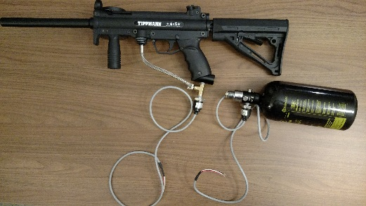
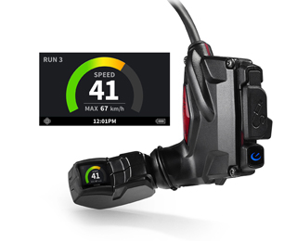
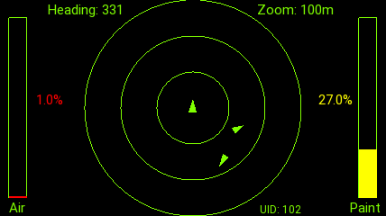
Paintball Environment Tactical Engagement Recon System
BCC-4
Objective
Develop a system to enhance situational awareness in the game of paintball. This system will utilize a Heads-Up Display (HUD) connected to various sensors to present useful information to the user. The sensor information will be recorded and processed through a Raspberry Pi.
Relative team member locations will be displayed on a representation of the playing field via the HUD. Locations will be updated at regular intervals. Sensor information will be used to indicate low air pressure and low paint levels for the user.
Paintball marker
with pressure sensor
Recon Snow2 HUD
Approach:
Key Milestones
Modify existing HUD to display required information by:
Obtaining necessary data from paintball marker.
Processing and networking data via Raspberry Pi
Developing Android app for HUD
Displaying necessary information on app
Final hardware mount for hopper complete 3/16
Execute app on HUD complete 3/16
Sensor data smoothing complete 4/16
Final hardware mount for air tank complete 4/16
Cross-User Communication complete 4/16
HUD Lat/Long coordinate gathering complete 4/16
Wireless data transfer between server and HUD complete 4/16
Field Testing / Debugging complete 5/16

